Slide 1
HOME SECURITY
Automation
Team: Nexus

Slide 2
CONTENTS
System Overview | Quick overview of how our system works
Camera Module | This module would involve hardware setup, calibration, and ensuring the camera captures high-quality images suitable for processing
Processing Module | This includes image processing and object detection using a machine learning model
Alert System | Generates alerts based on the processed data.
Data Storage Module | Stores the captured images or processed data for future reference or analysis.
Code and implentation | Provides a user-friendly interface for users to view live feeds, access stored data, and manage settings

Slide 3
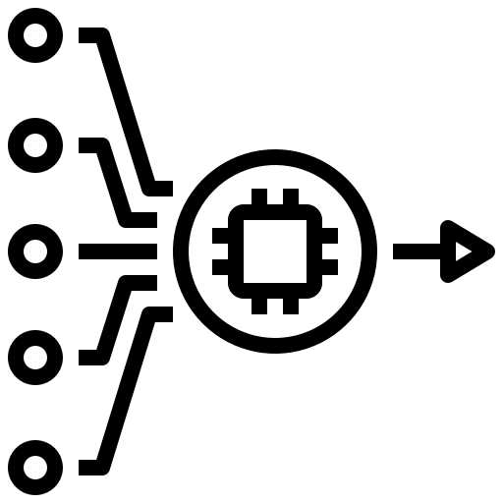



System Overview
Input : The system uses a Raspberry Pi Camera Module to continuously monitor the home.
Processing : A Raspberry Pi processes the live feed, detects motion using OpenCV, and triggers alerts.
Output: When motion is detected, the system sends an email with snapshots and can activate an alarm to deter intruders.
Storage: Recordings are securely stored either locally or on the cloud.
User Interface: The user can control the system and view updates through email alerts.

Slide 4
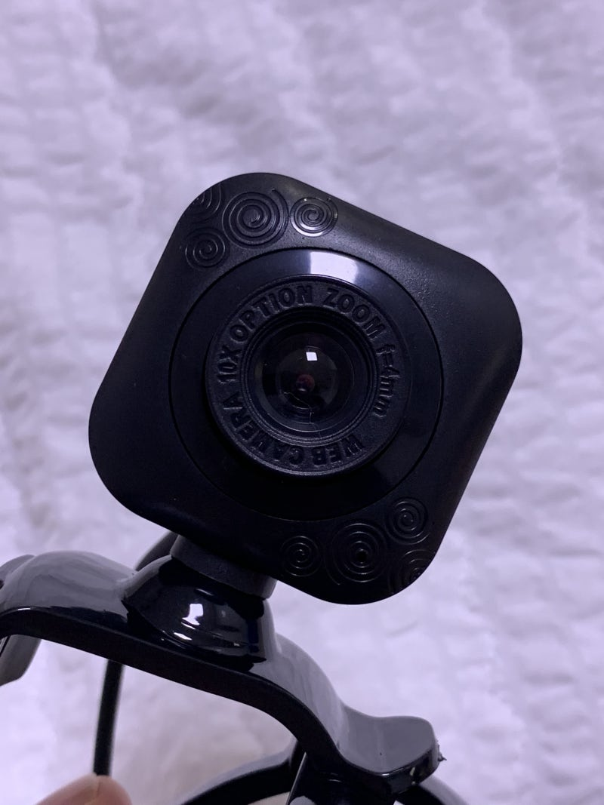
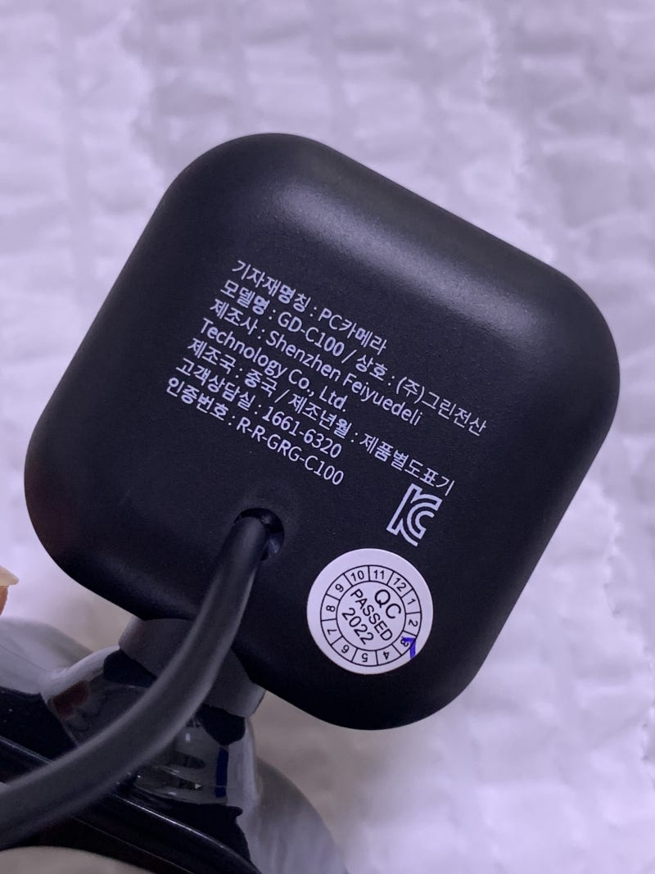
Camera Module
Our USB camera(GD-C100) is capable of capturing in high-quality. It supports real-time video feed and motion detection, ensuring that no activity goes unnoticed.
300.000 pixels
30 frames
60 degree angle of view
Manual focus
Length 1.8m

Slide 5

Email-Based Monitoring:
Instead of relying on apps, users receive instant alerts via email. Each email includes snapshots of any detected motion, ensuring they have clear evidence and can take appropriate action.

Slide 6
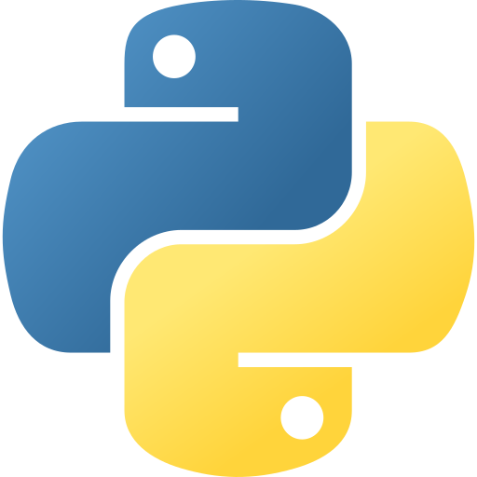
Processing Module
The Raspberry Pi 4 Model B is the heart of the system, handling motion detection algorithms and communication protocols. Python and OpenCV enable efficient processing and accurate detection.

Slide 7
Hardware: Raspberry Pi
Model Used: Raspberry Pi 4 Model B.
CPU: Quad-core Cortex-A72 processor.
RAM: 2GB/4GB/8GB, depending on the project's complexity.
Connectivity: Built-in Wi-Fi and Bluetooth for network communication.
Why Raspberry Pi?
Compact and affordable.
Supports Python and Linux-based operating systems like Raspbian OS, which are ideal for IoT projects.
Processing Module

Slide 8

Alert system
In addition to email alerts, a buzzer provides an on-site alarm to deter intruders instantly.
Advantages of the Alert System
Real-time notifications via email ensure the user is always informed, even remotely.
The buzzer acts as an immediate deterrent to intruders.
The system is cost-effective, scalable, and easy to integrate with additional alert channels.

Slide 9
Alert system
Email Sending Function: send_email(attach)
This function:
Creates an Email Message:
A multipart email is prepared using MIMEMultipart, allowing text and attachments.
The captured image is read, encoded, and attached to the email.
Establishes a Connection:
Connects to Gmail's SMTP server (smtp.gmail.com) via port 587.
Starts a secure TLS connection and logs in with the provided credentials.
Sends the Email:
Sends the email using mail_server.sendmail().
Handles Exceptions:
Prints an error message if the email fails to send.
Email Setup
Sender Email Credentials:
gmail_user: Sender's email address.
gmail_pwd: Sender's email password (you might need an app password for Gmail if 2FA is enabled).
Recipient Email:
to: Receiver's email address.
Message Content:
subject: Email subject.
text: Body of the email.

Slide 10
Alert system
Image Capture and Email Trigger: capture_and_send()
This function:
Initializes the Camera:
Uses OpenCV's cv2.VideoCapture(0) to access the default camera.
Captures an Image:
Reads a frame from the camera (cap.read()).
Saves it as a JPEG file with a timestamp-based filename.
Sends the Image via Email:
Calls send_email() with the image as an attachment.
Cleans Up:
Deletes the image using os.remove() after sending the email to free up space.
Continuous Monitoring:
Captures and sends images every 30 seconds using an infinite loop (while True).
Graceful Exit:
Allows the user to stop the program with Ctrl+C (handled by KeyboardInterrupt).

Slide 11
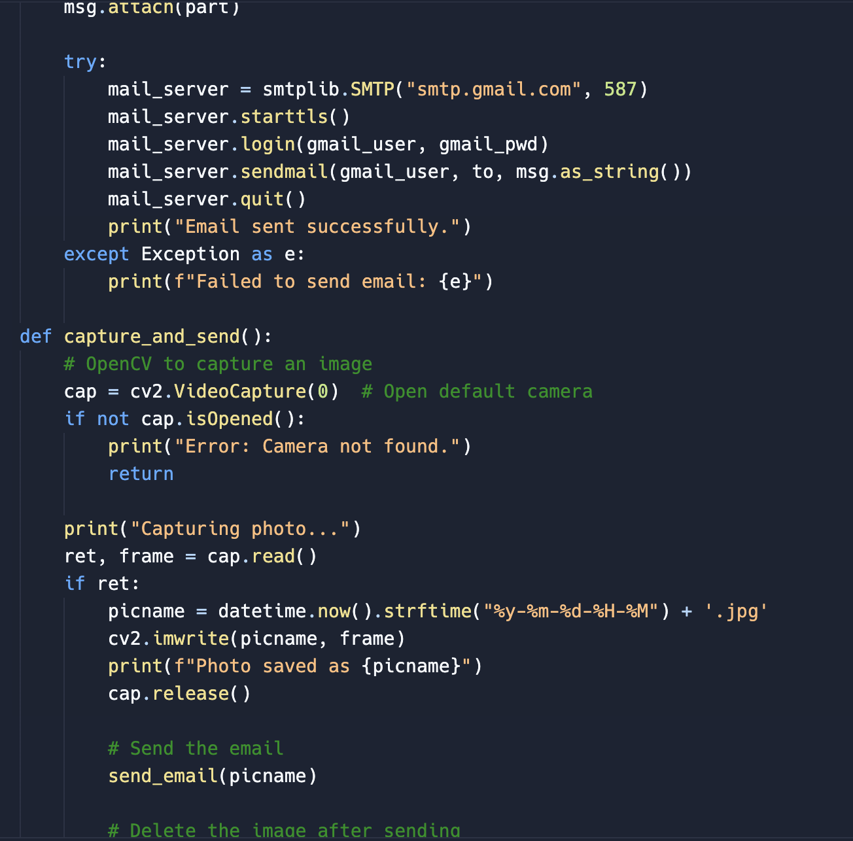
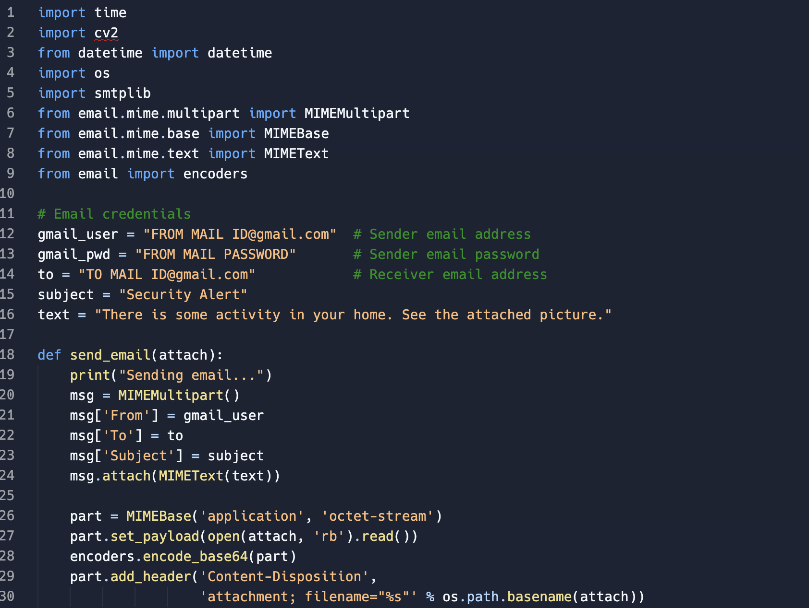
Alert system

Slide 12
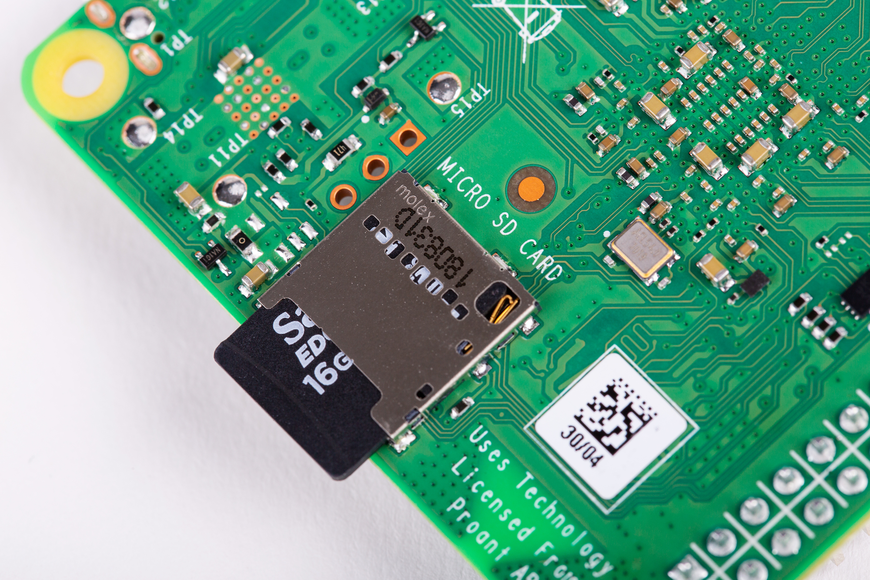
Data storage module
Local Storage
Hardware:
The Raspberry Pi uses an SD card (32GB/64GB/128GB) to store snapshots and video recordings.
Advantages:
Low latency for saving and accessing files.
No internet dependency for local access.

Slide 13

Code and Implementation

Slide 14
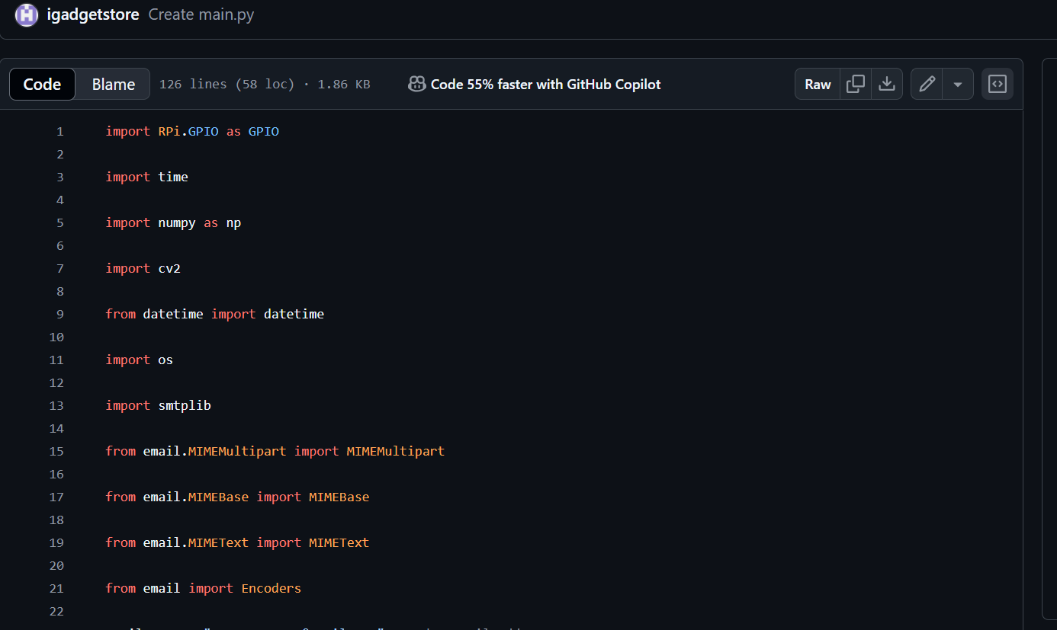

Slide 15
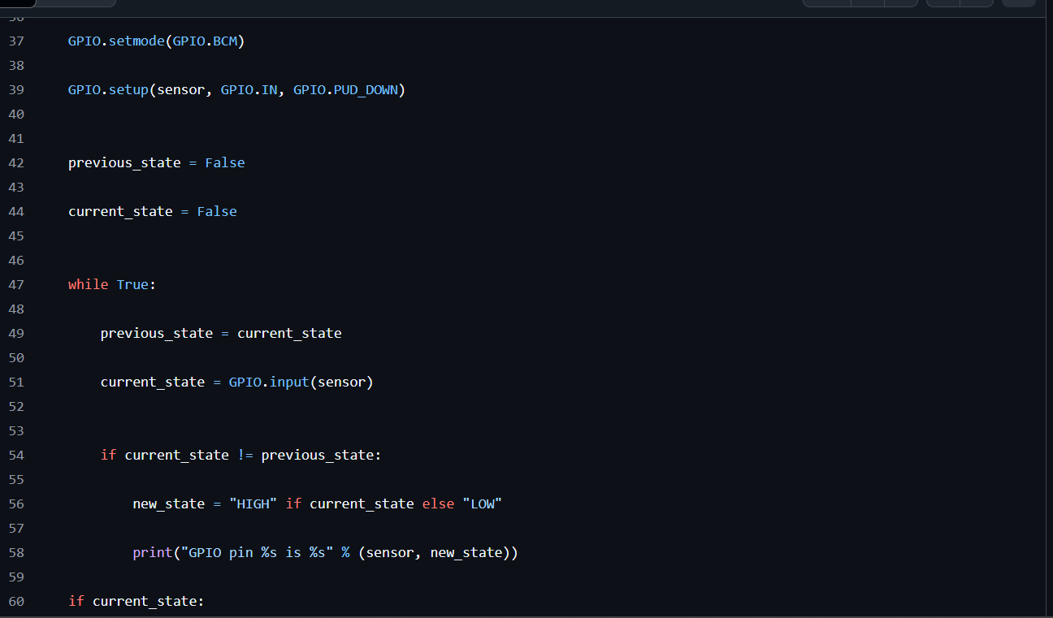

Slide 16
THANKS!
Do you have any questions?
Team: Nexus

